Slide 1
Civil War @ Home
By: Leslie Day

Slide 2
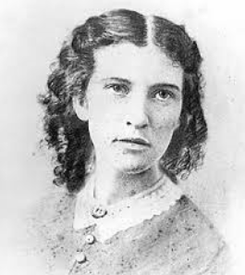
What experiences prior to the Civil War formed Elizabeth Blackwell’s Character?
Please answer question 1a during the video.
https://www.youtube.com/watch?v=VEEiG-nfHtc

Slide 3
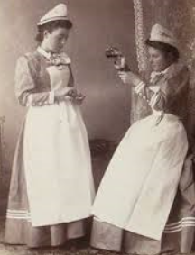
What role did Elizabeth Blackwell play in the Civil War?
She…
Organized the Women’s Central Association of Relief
Trained nurses who were going to help on the battlefield
Helped to develop the United States Sanitary Commission

Slide 4
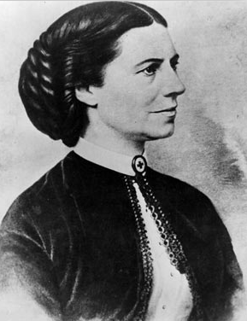
What experiences prior to the war formed Clara Barton’s character?
Clara was born in Massachusetts in 1821.
She was the youngest of five kids by ten years.
Her dad had been in the army, so her family was very patriotic.
She was a school teacher.
After teaching, she got a job in DC. She was persecuted in her workplace for being a woman.

Slide 5
What was her role in the war?
Clara and her sister brought needed medical supplies to the battlefield.
She organized a system to help the dying soldiers.
She fearlessly went to the wounded soldiers that were still on the battlefield.
She worked alongside the male surgeons and doctors, sometimes staying up for days with no sleep.
Nicknamed “Angel of the Battlefield”

Slide 6
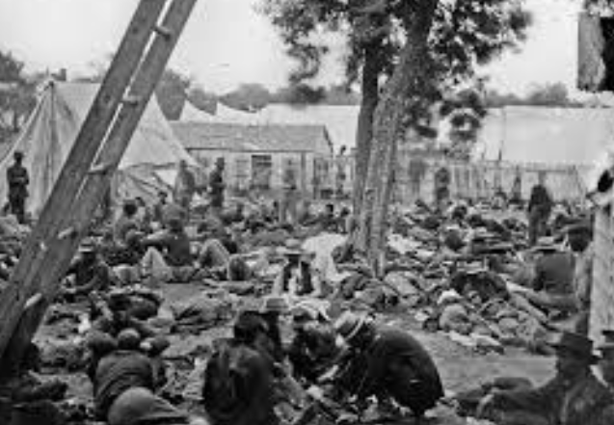
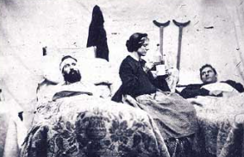

Slide 7
Clara Barton: Epilogue
After the war, she continued to help her country by…
Helping families find their sons, fathers, etc. who had gone missing in the war. She found 22,000 soldiers.
She helped identify soldiers who had died, and got them proper burials.
She made the American Red Cross for future generations.

Slide 8
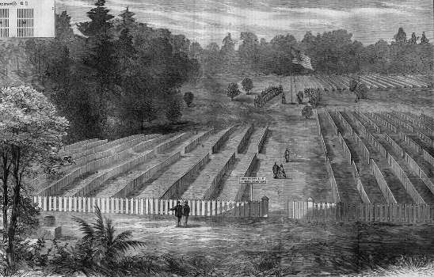
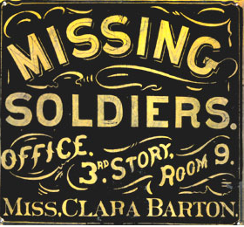
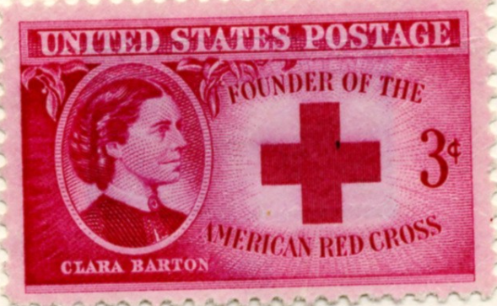

Slide 9
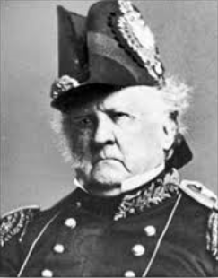
What experiences prior to the Civil War formed Winfield Scott’s character?
Winfield Scott was born in 1786, in Virginia, into a poor family.
His father died when he was young.
He married into a wealthy family.
He fought in the war of 1812 and was a respected military leader.
He ran for president in 1852, but failed.

Slide 10
What role did he play in the war?
He made the Anaconda Plan, which was successfully used to defeat the Confederacy.
He wrote “General Regulations for the Army” (Before the War) which was still in action.

Slide 11
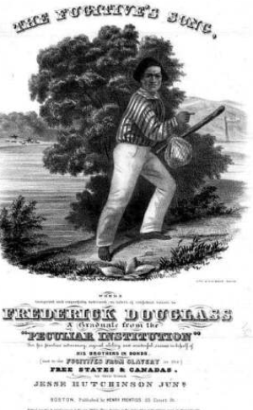
What experiences prior to the Civil War formed Frederick Douglass’ character?
He was born on the coast of Maryland in 1818.
He never met his dad, and only saw his mom a few times.
He became a slave at about fifteen, and was whipped every day.
He tried to escape, so he was sent to jail.
He successfully ran away two years later.

Slide 12
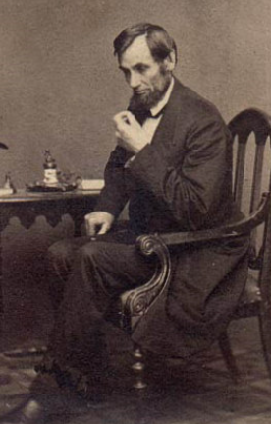
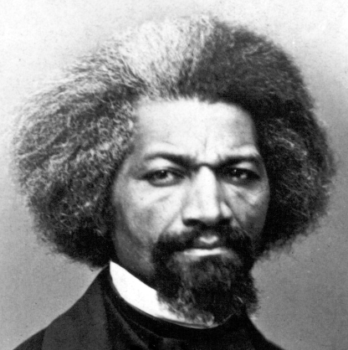
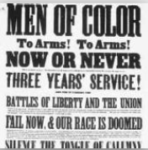
What was his role in the war?
Frederick Douglass worked with President Lincoln to get black men to volunteer with military service.
He was a recruiter.
He was an abolitionist who wanted the war to end slavery.

Slide 13
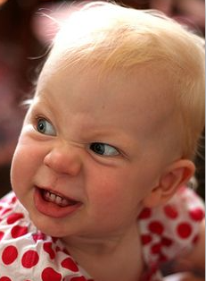
Who were the Copperheads?
Peace Democrats/ Copperheads
War Democrats
-(Union)-
Hated Lincoln
They pointed out all of his flaws.
Opposed the Emancipation Proclamation
Wanted to end the war
Many of them would prefer to have the Union lose the war so it would be over.
Used words to fight, not violence
Lincoln eventually got rid of them.
Didn’t agree with everything Lincoln did, but still supported him.
Wanted the Union to win the war.

Slide 14
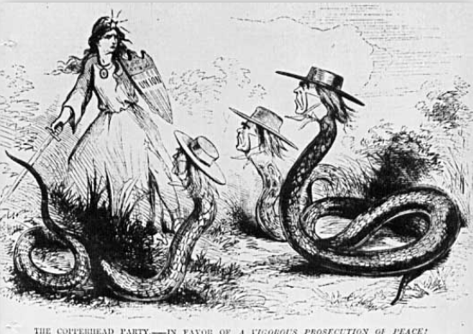
Propaganda

Slide 15
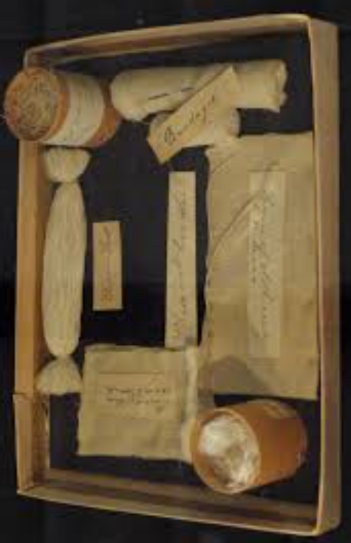
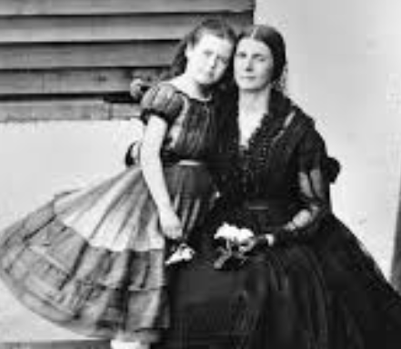
How did Southern and Northern Women affect the war efforts?
Women stayed home and worked on husband’s farms to supply food for the military.
There were several women spies, from the North and South, such as Rose O’Neal Greenhow and Elizabeth Van Lew.
Women worked as nurses or sent medical supplies to the army.

Slide 16
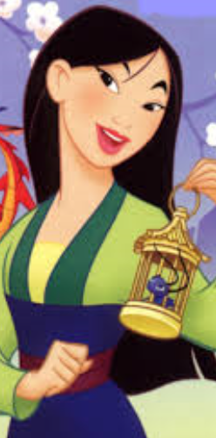
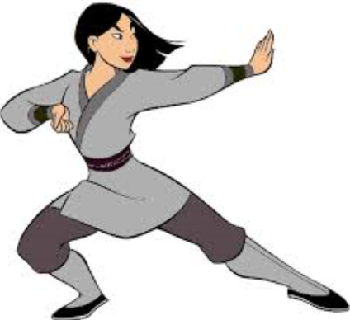
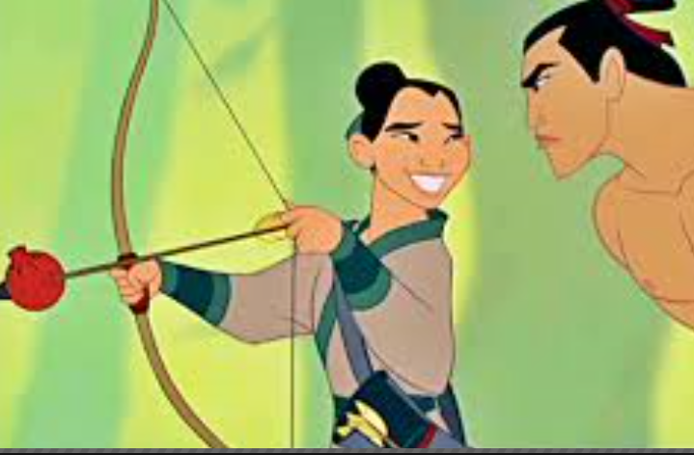
Women Civil War Soldiers
There was somewhere between 500 and 1000 female soldiers. It was fairly easy to be undetected because:
The military uniforms were really baggy
It never occurred to anyone that a woman might be wearing pants.
Technically, the only medical requirement was to be able to walk.
Fellow soldiers thought they were just teenage boys.

Slide 17
What are the Draft Riots?
Please answer question 7 during the video.
https://www.youtube.com/watch?v=TAWu2cPAsjo

Slide 18
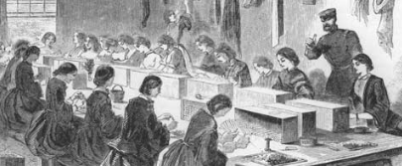
What economic struggles did Northerners face during the war?
For the most part, Northerners were better off than the Southerners.
Some of their factories started making weapons and ammo.
Families who lived near the fighting had their property trashed and belongings stolen.

Slide 19
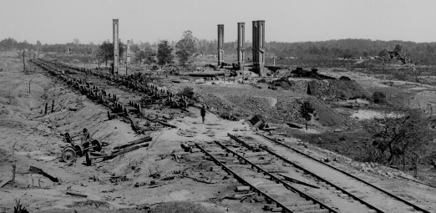
What economic struggles did Southerners face during the war?
Homes were damaged.
Large sections of the railroad was ruined, so it was hard to transport food.
Almost half of the military aged men left.
It was hard to get income to support families.

