Slide 1
Conflict Pre-Revolutionary War
By: Brooke Symkoviak

Slide 2
After the French And Indian War
Why did the British create new tax laws for the colonists?
Pay for the troops
Colonists were banned from making their own money
“No taxation without representation”
“Direct” and “Indirect” taxes

Slide 3
QUIZ!!!
What is the Difference between “Direct” and “Indirect” taxes?
What were two reasons the Parliament taxed the colonists?
How did the colonists protest?
What were the colonists banned from doing?

Slide 4
Sugar Act
What was the Sugar Act?
Sugar and Molasses
Lower taxes than the 1733 sugar act
British economy relied on cheap colonial sugar and molasses
Merchants smuggled in the goods
Lowered some parts of the economy

Slide 5
Stamp Act
What is the Stamp Act?
Put taxes on printed paper
Fined or put in jail upon refusal
Hardest hit tax law
Sons of Liberty
Considered first “Internal” tax law
There was a big celebration after it was removed
After it was removed, the declaratory act was placed

Slide 6
QUIZ!!!
Which act hit the colonists the hardest?
What was the Stamp act considered to be?
Why Was each of the tax laws removed?
The “Sons of Liberty” was a result of which Act?

Slide 7
The Boston Massacre
What Happened in the Boston Massacre?
People were insulting and harassing a British soldier
The soldier called for backup
In the chaos someone yelled “FIRE!!!”
3 people were killed right then, and 2 died later from wounds
The soldiers were put on trial months later, and 2 were accused of manslaughter

Slide 8
The Boston Massacre
Who Was Involved?
There were 9 soldiers present during the Boston Massacre
Captain Thomas Preston
Crispus Attucks
Samuel Gray and James Caldwell
8 wounded, 2 of which died later

Slide 9
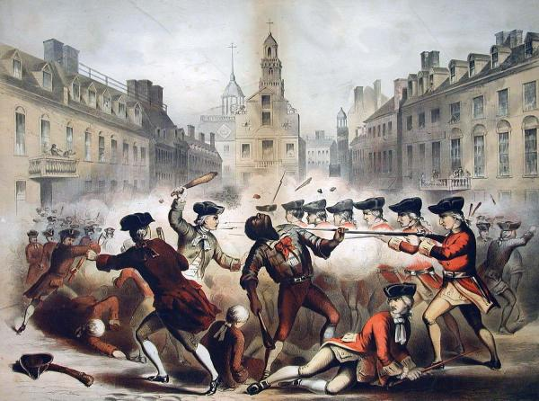
The Boston Massacre
How did the Colonists and British use this as Propaganda?
They exaggerated what happened and twisted it so it helped their side

Slide 10
QUIZ!!!
Who was the first person shot during the Boston Massacre?
What was the name of the captain of the soldiers?
How many people died?
Why did the soldiers start shooting?
How did the colonists use this as propaganda?

Slide 11
Townshend act
What was the Townshend Act?
Put import taxes on Glass, Lead, Tea, Paper, and Paint
“Daughters of Liberty”
Homemade clothes were a symbol of the American Resistance
“Sons of Liberty” carried out a boycott
The colonists signed pledges and made promises

Slide 12
Tea Act
What was the Tea Act?
After the Townshend act
The British East India Company needed help
Taxes on tea, except it was lower for The British East India Company
Disliked that tea, preferred others
Colonial merchants and shippers lost their jobs
Boycott and refusal to unload tea
Smuggled Dutch Tea

Slide 13
QUIZ!!!
What kind of protests did the colonists do for both acts?
______________ was a symbol of the American Resistance.
Which company was allowed to sell their tea with a lower tax rate?
Which type of tea did the colonists smuggle in?
Name two things that the Townshend Act put taxes on.

Slide 14
The Boston Tea Party
What was the Boston Tea Party?
It was the climax of protests against the Tea Act
It took 2 months to decide to do something big in protest

Slide 15
The Boston Tea Party
Who was involved?
Many People were involved, but they did not want to be known or identified
Many of the participants were in the organization “The Sons of Liberty”
George Hewes
Paul Revere

Slide 16
The Boston Tea Party
What happened?
3 ships arrived in the Boston Harbor
Colonists didn’t want to pay taxes, so they didn’t unload the ships
The Colonists dressed up as Mohawk Indians and snuck onto the ships
They broke the crates open, and dumped tea into the harbor

Slide 17
The Boston Tea Party
How was this event used as propaganda?
The colonists showed the British as weak

Slide 18
QUIZ!!!
How many ships arrived in the Boston Harbor?
Name one of the two people that were known Participants
How long were the ships in the harbor before the colonists took action?
What was the main organization involved in this event?
What was the tribe of Indians they dressed up as?

Slide 19
The Intolerable Acts
What were the Intolerable Acts?
The Intolerable Acts were called the Coercive Acts
They were placed as a punishment for the Boston Tea Party
They were a series of acts so harsh that the colonists renamed them the Intolerable Acts

Slide 20
The Intolerable Acts
The Boston Port Act
Shut down the Boston Harbor until the colonists paid taxes on the tea they dumped
They were not allowed to receive shipments from anywhere
The other colonies helped Boston to show Great Britain that they could survive on their own

Slide 21
The Intolerable Acts
The Quartering Act
The quartering act required colonists to let soldiers stay in their homes
Soldiers would take anything they wanted
Soldiers would harass the Women and girls

Slide 22
The Intolerable Acts
The Quebec Act
Expanded the boundaries of Quebec to the Ohio River
Was used so the colonies would not expand west
It was also an attempt to isolate Massachusetts from the other colonies

Slide 23
The Intolerable Acts
How did these acts lead to the 3rd and 4th amendments?
The Third amendment was a result of the Quartering Act
It said basically that the soldiers could never house in someone’s house without the owners permission
The fourth amendment was also in a way a response to the Quartering Act
It protects your property and your rights, and in times of war the soldiers would just burst in and take whatever they wanted

Slide 24
QUIZ!!!
What were the Intolerable Acts originally called?
Where did the Quebec act extend Quebec’s boundaries to?
Why were the Intolerable Acts placed?
The 3rd amendment was a result of which act?

Slide 25
Knowledge Quest!!!
After the French and Indian war, what were the colonists Banned from doing?
The “Sons of Liberty” was a result of which act?
Who was the first person shot during The Boston Massacre?
During the Townshend Acts, what was a symbol of the American Resistance?
Which tribe of Indians did the colonists dress up as during the Boston Tea Party?
What were the Intolerable Acts originally called?

