Slide 1
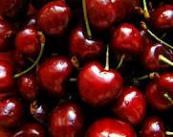
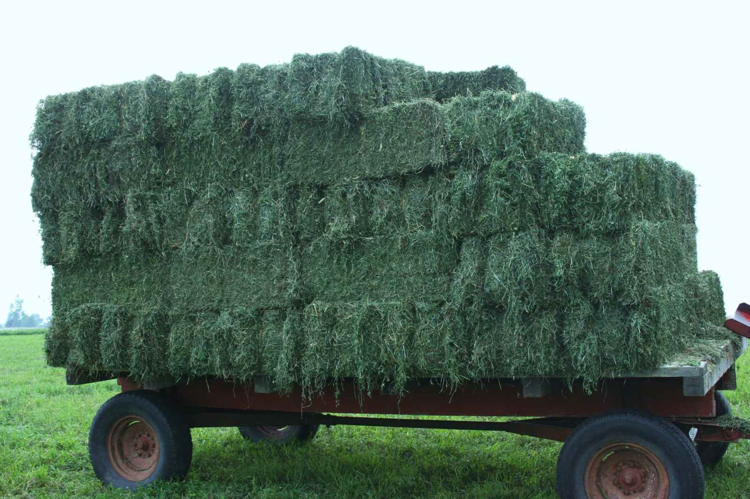
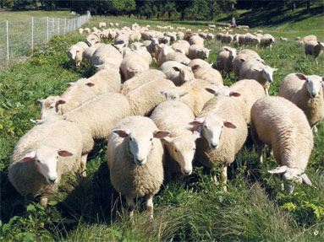
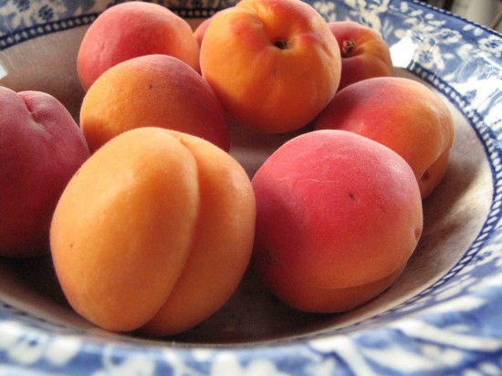
What do all these things have in common?

Slide 2
Utah Farming, Ranching, & Energy

Slide 3
Farming
Watch the video clip & write down 2 things you learn
Utah County Seat Season 2, episodes 37

Slide 4
3 Primary Energy/ Natural Resources in Utah
Uranium
Copper Ore
Wind

Slide 5
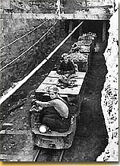
Utah Energy & Natural Resources
Charles Steen discovered rich deposits of uranium in Moab in the 1950s
Uranium was used to help make atomic energy during the Cold War
Moab became a boomtown as prospectors, miners, and business men moved in.
Moab gradually switched from a mining town to a tourist town

Slide 6
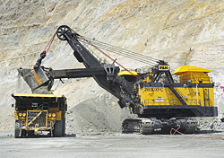
Bingham Copper Mine
Also known as the Kennecott Copper Mine
Open-pit mining operation for copper deposits
Deepest open-pit mine
World’s largest man-made excavation
Been in production since 1906
Pit is over .75 miles deep & 2.5 miles wide, covering 1900 acres

Slide 7
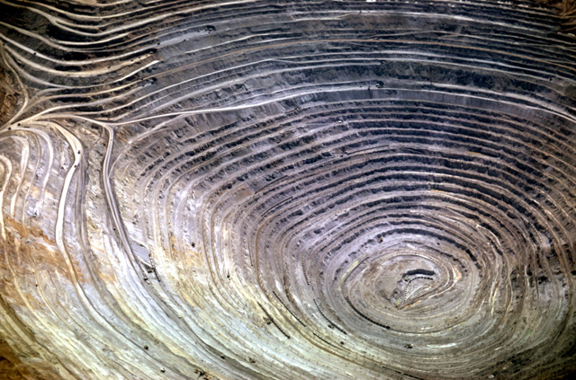

Slide 8
Bingham Copper Mine History
Copper ore first discovered in 1848 by two brothers: Sanford & Thomas Bingham, son of Erastus Bingham
Not until 1868 that first mining of ore began and the potential of the mineral resources began to be recognized

Slide 9
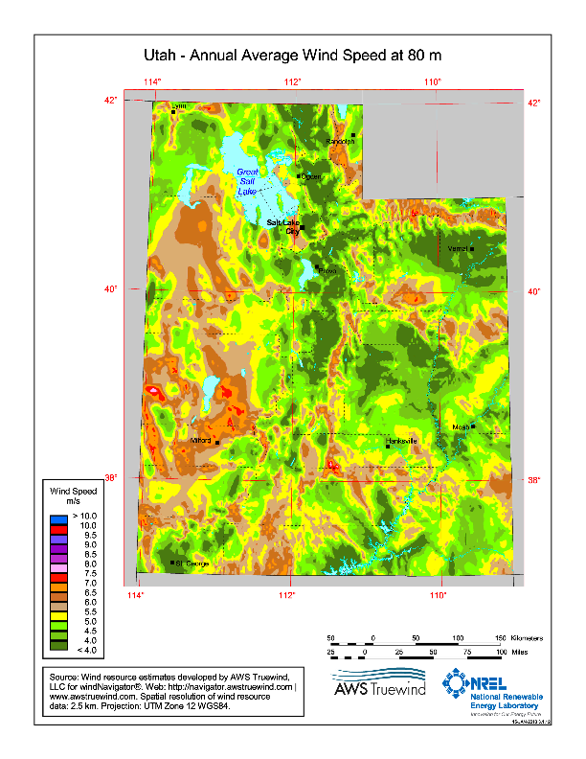
Renewable Energy: WIND

Slide 10
What other natural resources do you know of?

Slide 11
Ranching
Utah produced $1.4 billion in cash receipts for crops, livestock, produce etc… in 2010
32% of Utah’s farm cash receipts- $487 million- comes from meat sales (beef, hog, & sheep)
Utah relies heavily on grazing distribution on public land (Bureau of Land Management) to support its range cattle industry

Slide 12
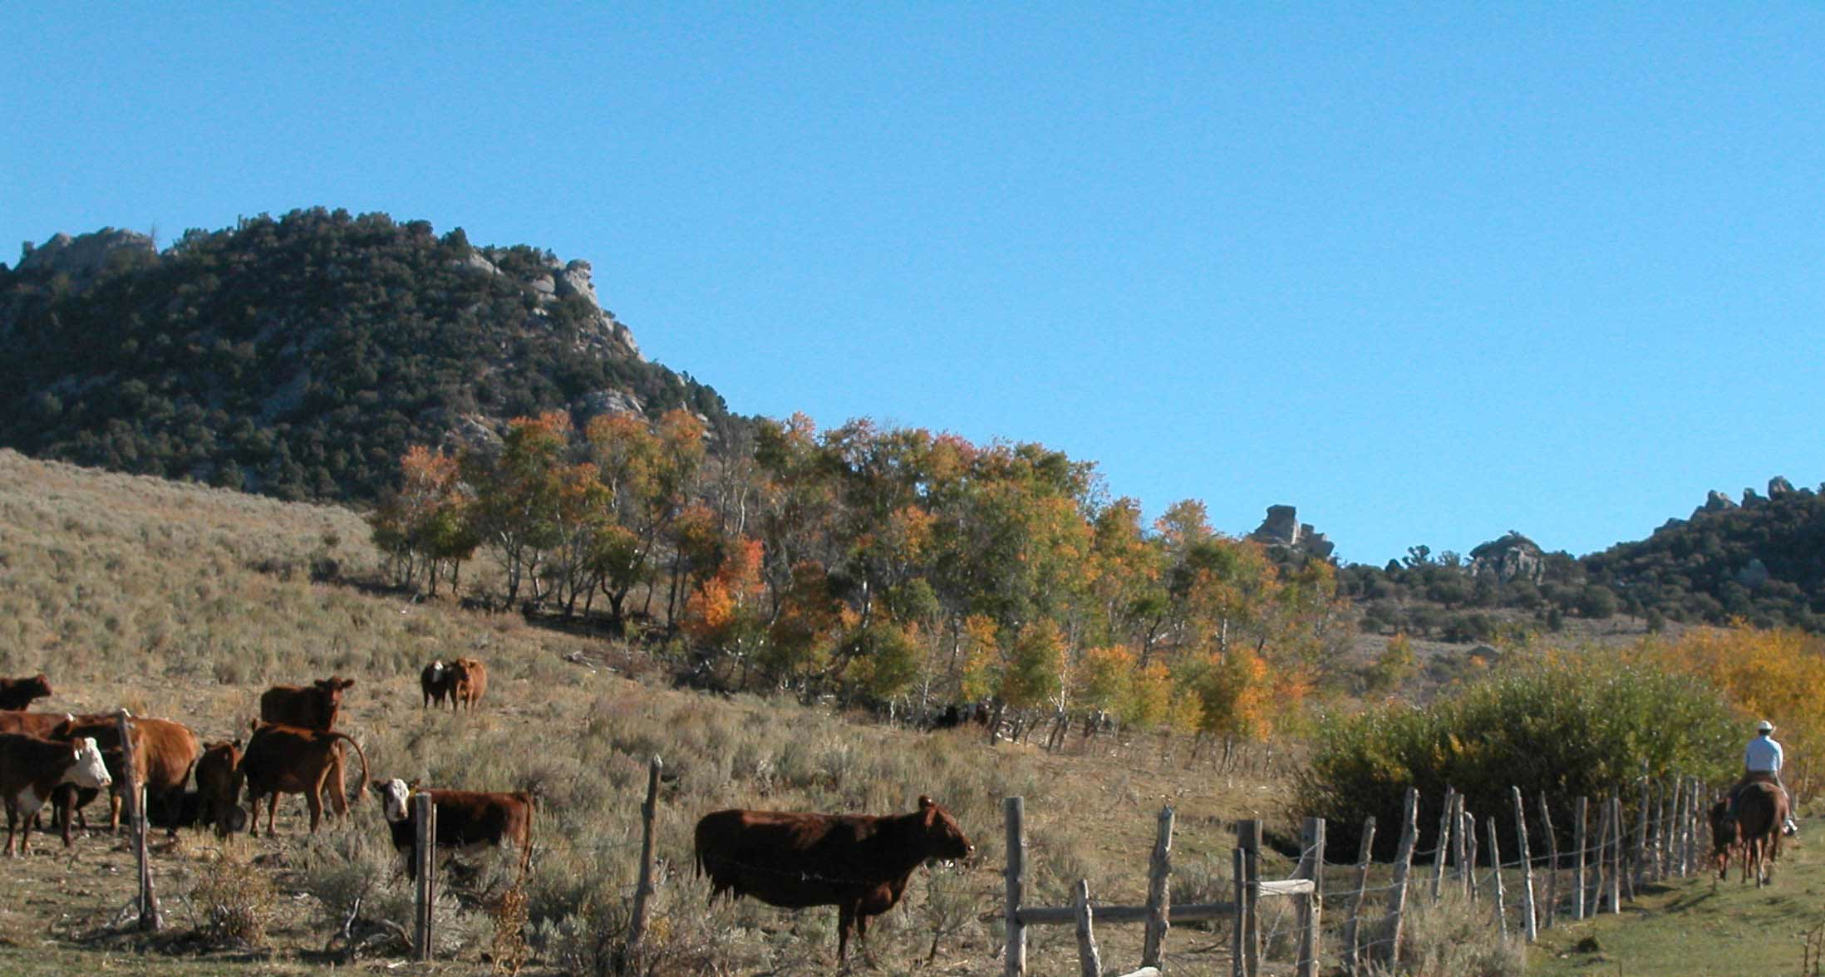

Slide 13
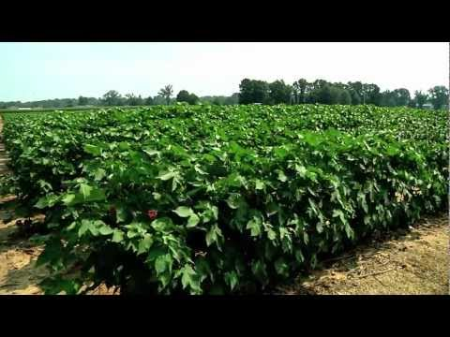
Farming
Utah’s growing season ranges from
60 days in Northern Utah to
190 days in Southern Utah
Utah’s annual precipitation varies- Utah is the second driest state in the nation
Utah grows barley, apricots wheat, dry edible beans, potatoes, onions, cherries, alfalfa hay, & corn

Slide 14
Utah Agriculture Statistics
13th in the nation for Barley production
9th in the nation for “Other Springs Wheat” production
14th in the nation for Alfalfa Hay production
3rd in the nation for Apricot production
2nd in the nation for Tart Cherry production
4th in the nation for Sheep Production

Slide 15
Journal Write
How has farming/ranching affected YOUR life?
Answer in complete sentences
Fill all the lines

