Slide 1
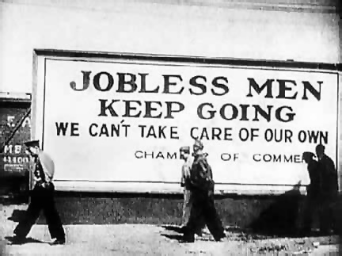
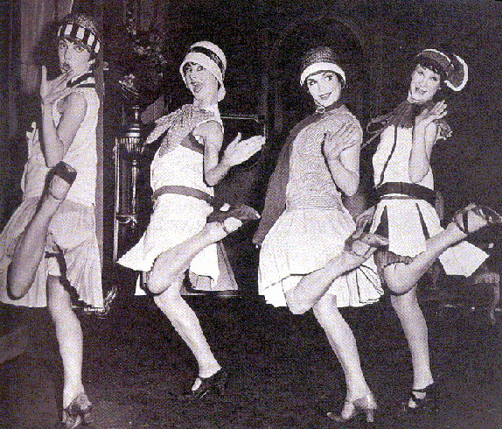
Great Depression & Roaring Twenties
Utah in the 1st Half of the 20th Century: 1900-1945

Slide 2
Brother Can You Spare A Dime?
Read the lyrics as you listen to the song
What kind of emotions does the singer mention/make you feel?
Write down at least three emotions and why you think the singer feels this way

Slide 3
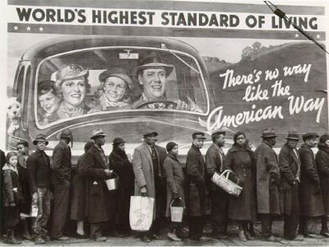
Great Depression
Severe worldwide, economic depression from 1930s to middle of the 1940s.
Key aspects of the Great Depression:
Mass unemployment
Inflation of prices
Drought & Crop failure (Dust Bowl)
Bread Lines

Slide 4
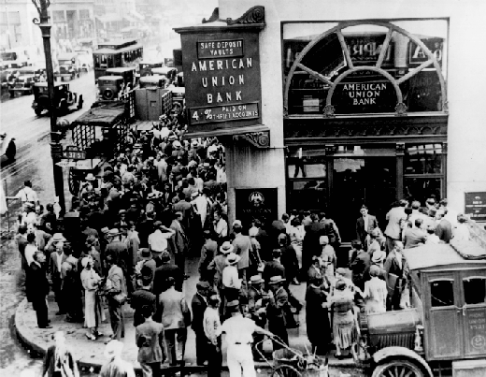
Trigger to Great Depression
Stock Market Crash
October 29th 1929
Called “Black Tuesday”
It’s a Wonderful Life- Bank Run Scene

Slide 5
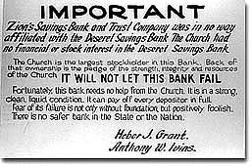
How did the Great Depression impact Utah?
1 in every 3 people in Utah were out of work during the Depression
At the height of the Great Depression, 1933, the average yearly income per Utahn was only $275.00
Utah was one of the states hit hardest by the depression: in some counties (Duchesne & Uintah) unemployment was 75%.
Many parents & children searched through dumps & restaurant garbage cans

Slide 6
Recovery Plans
President Franklin D. Roosevelt
New Deal
Series of economic programs put into place by President Franklin D. Roosevelt in response to the Great Depression
Focus on 3 R’s
Relief- for the unemployed & poor
Recovery- of the economy to normal levels
Reform- of the financial system to prevent another depression
Fireside Chats

Slide 7
Roaring Twenties
BEFORE the Great Depression:
Roaring Twenties- a time of great wealth & excess
Women’s Suffrage: earned right to vote in 1920
Prohibition: attempts to ban alcohol

Slide 8
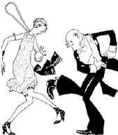
Flappers & Jazz!
Charleston- popular dance of the time
Women bobbed their hair (cut their hair short) & wore short skirts for the first time
Flappers: “a fashionable young woman intent on enjoying herself and behaved in bold unconventional manner.”
Jazz Age- jazz music & dancing become popular. Pop Culture!
We get to learn how to Charleston! GET EXCITED!

Slide 9
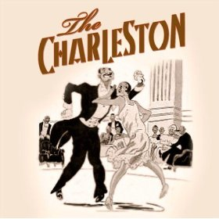
CHARLESTON!!

Slide 10
Videos
As you watch the video about the Stock Market Crash & Dust Bowl
Write down 3 interesting things that stick out to you
In complete sentence
On the back of your PINK Great Depression/Roaring Twenties Study Guide

Slide 11
Group Projects
4 people to a group
10 groups
Pick topic from below list:
1920s Style & Women’s Suffrage
Prohibition & Jazz Age
Dust Bowl
New Deal
Poster & rubric

