Slide 1
Novel Project
By Landon Schiess
The Journal of Jasper Jonathan Pierce

Slide 2
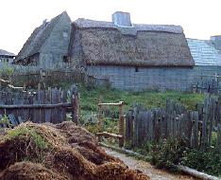
Daily Life in plymouth
Daily Life was not exactly what you may have learned of the Pilgrims.
Only wore black and white on Sundays.
Had Governor and his 7 assistants
Every March the governor and his assistants made new laws

Slide 3
The Journey
The Journey from England to Plymouth was hard.
It included storms that could sink the ship.
Horrible waves that threatened to rip the boat and send it to the bottom.
High winds or storms sent the passengers into the inside.

Slide 4
Interactions with native
The Native had helped the Pilgrims
The Native gave the Pilgrims food and taught them how to farm
The Native taught the Pilgrims the way of the land

Slide 5
Sources Cited
http://www.east-buc.k12.ia.us/00_01/CA/ply1.htm
Http://www.ushistory.org/us/3a.asp
http://www.history.com/topics/plymouth

