Slide 1
Polygamy & Utah’s Struggle for Statehood
Objective: Students will understand the problems facing Utah in the late 19th century and the process (and eventual success) of Utah’s struggle for statehood.

Slide 2
Why Become a state?
Rights of citizenship
Represented in the government
Elect their own leaders
Pay taxes
Receive government services
Freedoms of citizenship

Slide 3
What problems got in the way of Utah and STATEHOOD?
POLYGAMY
Size and borders of the territory
Tensions with Native Americans
POLYGAMY
Church and State
Slavery (prior to the Civil War)
POLYGAMY
Political Parties
Tensions with the U.S. Government- Rebellion & Military issues

Slide 4
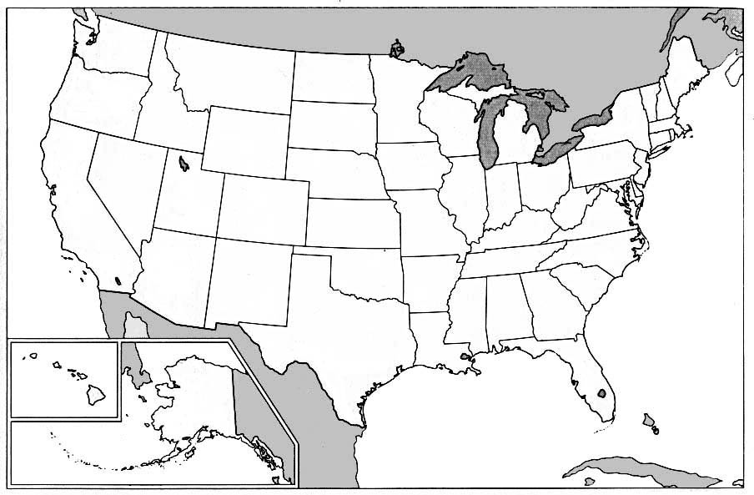
If you had to draw the boundaries for your own state, what would you make sure was inside of it?
Brainstorm and think of the vital resources, geographical features you would want to make sure were part of your state.

Slide 5
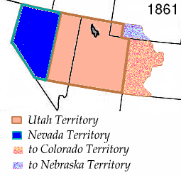
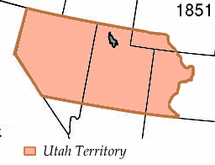
Utah Territory

Slide 6
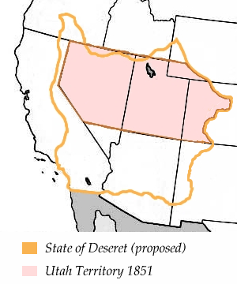
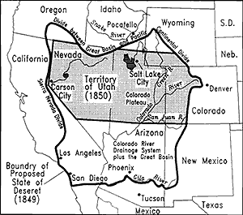
State of Deseret?
Deseret: honeybee/bee hive
Word from Book of Mormon
Brigham Young wanted the land to be dedicated
Term to inspire Mormons to be a productive, hard-working community, like a beehive. Industry!
State covered 16% of the nation, larger than Texas & Alaska

Slide 7
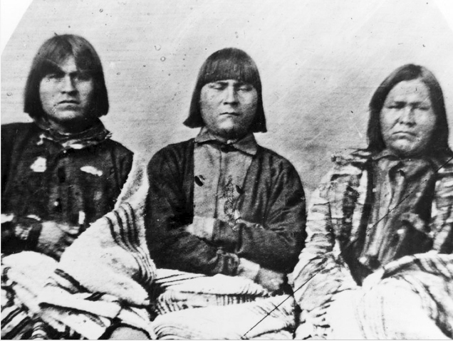
Native Americans
Look at the picture on page 127 in your Utah history textbook
-Who are the different people in the cartoon?
-What is the cartoonist trying to say about each group?
-Why would this be a problem for Utah's pending statehood?

Slide 8
Discussion
List 5 qualities you think every good American should have.
Discuss with your partner and come up with your top 3 qualities.

Slide 9
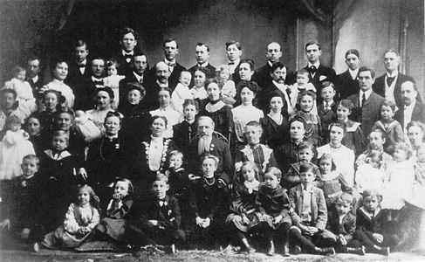
Polygamy
Definition of polygamy: the practice of having more than one wife at a time.
The Mormon church publicly announced the doctrine of plural marriage in August 1852

Slide 10
Reasoning
The Mormons defended that their reason for practicing plural marriage included:
God had commanded the reestablishment of the sacred practices of the Israelite patriarchs and kings
Repopulation of the Earth
A commandment from God
Mormon Church’s Official reasoning:
“In this dispensation, the Lord commanded some of the early Saints to practice plural marriage. The Prophet Joseph Smith and those closest to him, including Brigham Young and Heber C. Kimball, were challenged by this command, but they obeyed it. Church leaders regulated the practice. Those entering into it had to be authorized to do so, and the marriages had to be performed through the sealing power of the priesthood. In 1890, President Wilford Woodruff received a revelation that the leaders of the Church should cease teaching the practice of plural marriage.”
– mormon.org

Slide 11
How many practiced polygamy?
Mormons claimed only a small number of men were polygamous in the 1880’s.
Mormons insisted that only about 2-3 percent were polygamous.
Other evidence shows most likely about 20-30 percent were.
Marriage numbers did recede during the 1870-1880’s, because of governmental pressure.

Slide 12
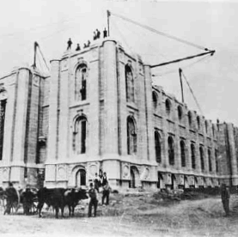
Federal Reaction to Polygamy
1869 Gave women in Utah the right to vote
The Edumnds-Tucker Act (1887)
1) Required plural wives to testify against their husbands
2) Took away the vote form Utah's women
3) Abolished the local militia
4) Confiscated the property of the LDS Church.

Slide 13
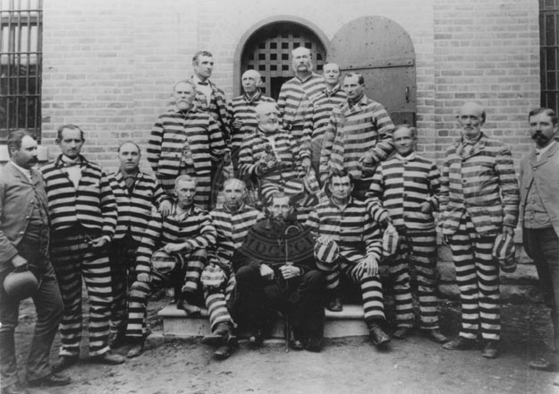
Prison Time
If someone was caught the punishment could be the following:
5 years in prison
$500 Fine
Eventually Mormons realized they needed to fall in line with the government. Mormon church President John Taylor stated that the Mormons would follow constitutional law. Except for the anti-polygamy Edwards act.
Over 1000 polygamists were put in prison.

Slide 14
Discussion
According to our standards, would polygamists be considered good Americans?
How much can a person or group be different and still be considered a good American?

Slide 15
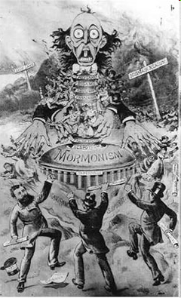
Stereotypes
Throughout the United States polygamy was viewed as rampant. (people thought everyone in Utah was doing it)
People heard of men having 20-50 wives an that wives were forced to be slaves to the men.
People began to feel hatred and disdain towards members & Utahns.

Slide 16
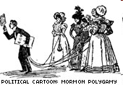

Slide 17
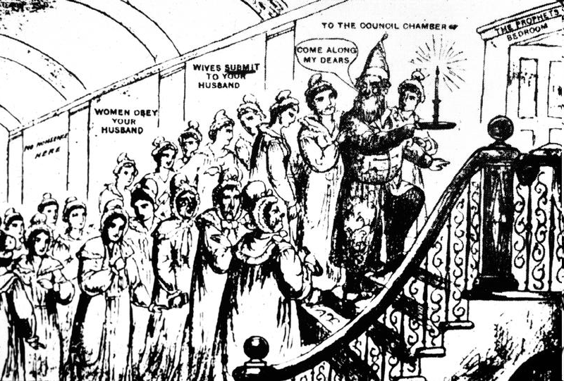

Slide 18
Journal Write 150 words
Would you be willing to share your spouse, or take a second, third, etc.. Spouse? What might be some of the advantages and disadvantages? Under what circumstances, if any, would you be willing to practice polygamy? Explain

Slide 19
POLYGAMY Video
Watch the video: Utah’s Struggle for Statehood & Answer the questions: #13-26

Slide 20
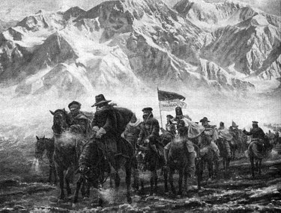
Tensions with U.S. Government
“Utah War”-series of armed confrontations between Utahns & the Federal Government from May 1857 to July 1858.
Not a true “war.” There were no official battles
President Buchanan heard rumors of a supposed “rebellion” in Utah, sent Colonel Johnson’s Army to put an end to it.
War was avoided. Tensions eventually died down.
Mountain Meadow’s Massacre- September 1857
Due to massive war hysteria & fear of outsiders, Utahns attack and kill 120 people in a wagon train headed West.

Slide 21
Steps to Statehood: Join National Parties
In the Utah territory most Mormons voted the same. Why would they vote the same?
Many Mormons lost the right to vote because of Federal laws against polygamists.
In order to fall in line with the rest of the nation the LDS church encouraged it’s members to join one of the two national parties.
1892: First two party elections held in Utah
1893: Bill written to admit Utah into the Union passes in Congress

Slide 22
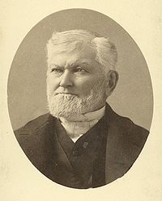
Steps to Statehood: End Polygamy
The Manifesto
Statement made by the Mormon 1st presidency and quorum of the twelve in 1890, ending any new polygamous marriages.
I publicly declare that my advice to the Latter-day Saints is to refrain from contracting any marriages forbidden by the law of the land.
-Wilford Woodruff, President of The Church
of Jesus Christ of Latter-day Saints

Slide 23
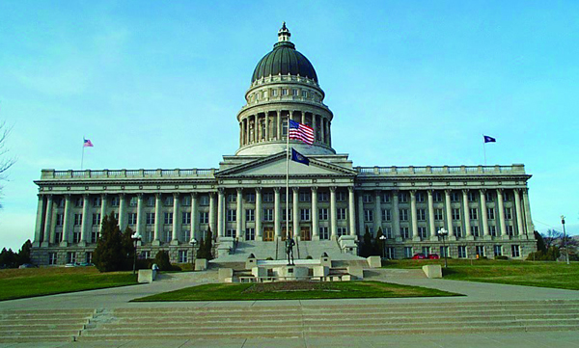
Steps to Statehood: apply AGAIN
1895 - Delegates attend Utah Constitutional Convention
The new constitution was put up for a vote and was accepted in a vote of 31,305 to 7,687.

Slide 24
Author’s of Utah’s Constitution
Party | Age | Occupation | Birthplace | Religion
59 Republicans 48 Democrats | 24-76 | 28 Farmers & Ranchers 15 Lawyers 13 Merchants 8 Mining Businessmen 6 Educators 5 Churchmen 4 Newspapermen 3 Bankers 3 Builders Others, including a Photographer, a blacksmith, a clerk, a mason, a brewer and a druggist. | 47 Other Territories or States 37 Foreign Countries 28 Utah Territory | 79 Mormons 2 Catholics 1 Episcopal Minister 1 Jew 1 Methodist
Draw some conclusions.
Identify what were some of the prominent jobs of those who wrote the Constitution.? What does that say about the values of Utah?

Slide 25
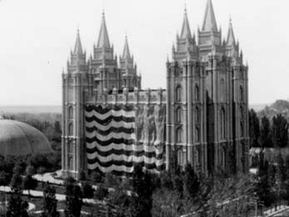
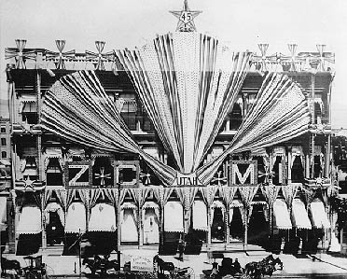
JANUARY 4, 1896
Utah becomes the 45th State!

Slide 26
Timeline
1850: Utah First applies for statehood. It is denied.
1850: U.S. Congress establishes Utah territory. Brigham Young is appointed the first governor.
1852: The L.D.S. Church officially announces the practice of polygamy, when one man is married to multiple women.
1857-1858: “Utah War” begins. Johnston’s federal armies are sent from the east. Mountain Meadows Massacre
1861: Outbreak of the Civil War in the South. Johnston’s army leaves Utah.

Slide 27
Timeline Continued
1869: Utah’s women gain suffrage (the right to vote). In 1887 it is taken away until the 19th amendment allows all women to vote.
1887: Edmunds Act passes in Congress. Polygamist arrests intensify and many husbands go into hiding.
1890: The Manifesto, issued by Wilford Woodruff (President of the L.D.S. Church), ended the practice of plural marriage.
1896: Utah becomes the 45th state!

Slide 28
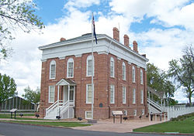
First State Capital
Fillmore, Utah

Slide 29
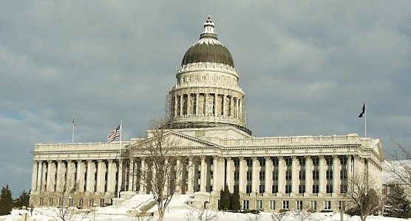
State Capital Today
Salt Lake City, Utah

Slide 30
Utah’s Constitution
Preamble
24 articles
Rights
Obligations
Laws

Slide 31
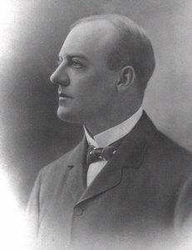
First State Government
Governor: Heber M. Wells
Directs state government
Commander in chief of the national guard
Present bills to the legislature
Signs or vetoes bills
Pardon people convicted of crimes
County
Taxes, elections, carry out laws
City
Offer services such as streets, parks, water, and sewage
Mayor and city council

Slide 32
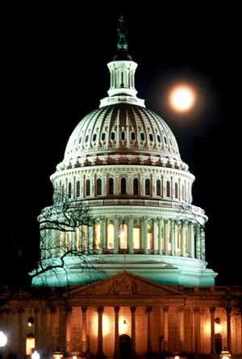
Utah and United States Governments
Both Utah and America have governments based on Checks and Balances
There are three branches of Government in the state and federal governments
The Executive, Legislative, and Judicial

Slide 33
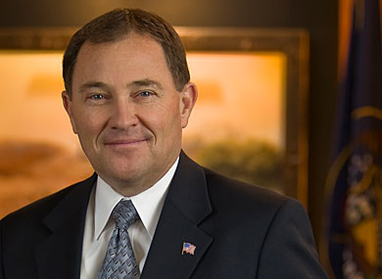
Executive Branch
Governor: Gary Herbert
Lieutenant Governor: Greg Bell
The Executive administers the laws
Who leads the executive branch in the United States government?

Slide 34
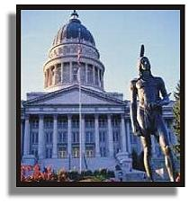
The Legislative Branch
Write the laws
The House of Representatives
elected by population
The Senate
2 for each state

Slide 35
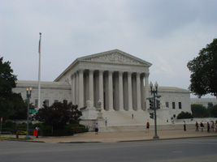
Judicial Branch
Courts and Judges
Apply and interpret the laws

