Slide 1
The Pueblo Revolt
Serafina’s Stories Project
By Alissa McConkie
Period: A4

Slide 2
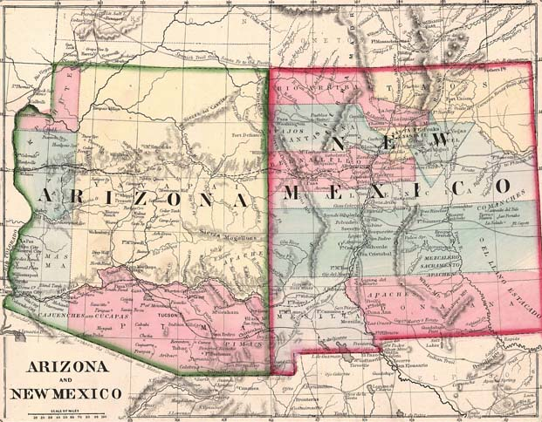
Definition: Pueblo Revolt
When the Pueblo Indians revolted agenst the Spanish in Santa Fe New Mexico in 1680

Slide 3
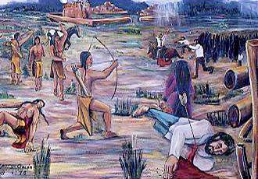
What happened?
The Spanish people that came from Spain to Santa Fe New Mexico didn’t want the pueblo Indians to be believing in anything but the Christion faith. So they started to make laws forbidding the Indians to participate in anything that was related to the Indians religion. The Indians finally said they where done with the laws and they rebelled against the Spanish in the 1680s.

Slide 4
Facts
More than 400 Spaniards where killed.
Otermin attempted to re-conquest New Mexico in 1682.
Pueblos maintained self-ruled for 12 years.
After New Mexico got conquered again in 1692, 14 Pueblos attempted another revolt.
Eventually they gave the Pueblos the freedom on religion, cultural autonomy and allowed the Pueblos to self- govern.

Slide 5
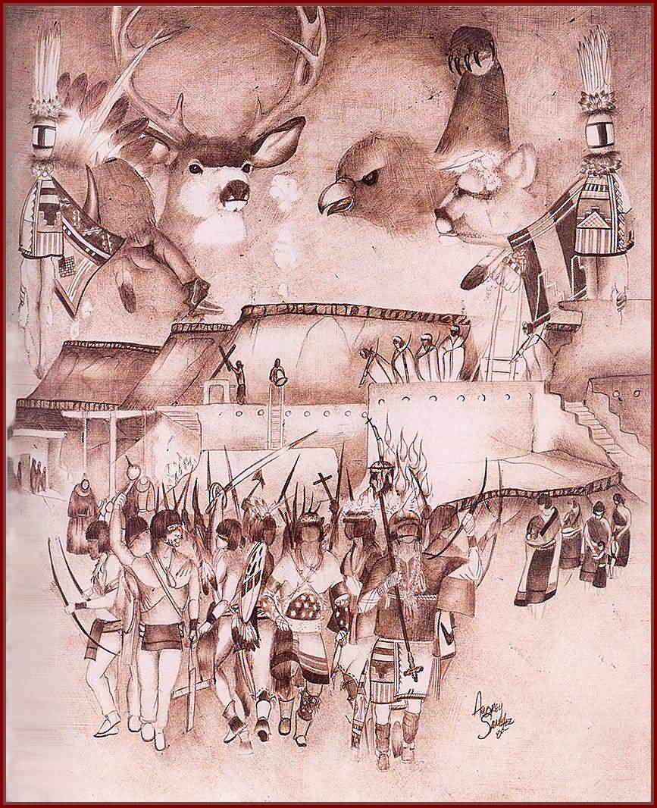
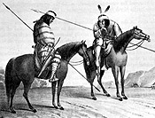
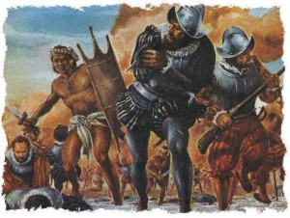
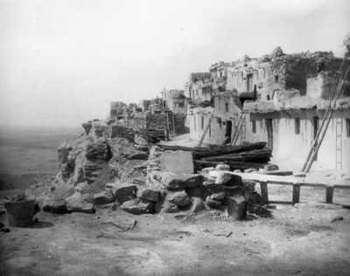
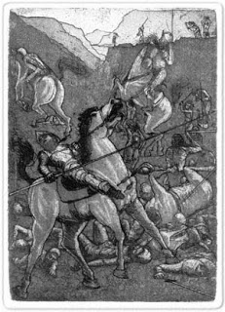
Images

Slide 6
What I Learned
What I learned while doing this project was that the Spanish didn’t treat the pueblo Indians very well so then the Indians finally said enough was enough and then the pueblo revolt started and to me it sounded liked it turned out pretty good for the pueblos because they got what they wanted but it only lasted 12 years so I don’t think it helped much because like I said in my power point in 1696 they finally got there freedom of religion and they got to be self-ruled. I also learned that before the pueblo revolt the Spanish killed thousands of pueblos and that the pueblos only killed about 400 Spanish people. Because of that I believe that the pueblos where less violent and cared more about people than the Spanish. Something I also found interesting when I was doing research and reading my book I thought why couldn’t the Spanish just leave the Indians culture alone and not force them to give up there cloture to believe in the Christion faith. If the Spanish just left them alone then the whole pueblo revolt wouldn’t have happened and the thousands of pueblos wouldn’t have died and the 400 Spaniards wouldn’t have died so it would just save a lot of people from dyeing. Something that I found interesting when I was reading the book was that serafina was part of the rebellion but she still believed in the Christion faith and in her pueblo faith but people still accused her of being a witch. What I also found interesting was that even after serafina prayed with a solider they still accused serafina of being a witch.

Slide 7
Sources
Google.com (images)
Wikipedia.org (information)
Socialistworker.org (information)
u-s-history.com (information)
Warpaths2peacepipes.com (information)

