Slide 1
WAR OF 1812
SAMANTHA SCHOW

Slide 2
IMPRESSMENTS
Who were involved
The citizens were forced to be in the navy or army.
This was in 1807
United States citizens
United States navy
United States army
British navy
Chesapeake's captain

Slide 3
embargo act
Where the colonist can trade with foreign countries. They were loosing a lot of money. The government thought they were protecting the American ships form Britain and France. New York and New England got hurt the worst because the relied on trading. This started in December 1807 and by December 1808 they have gotten 199 petitions. This did not hurt Britain and France, Britain had started to trading with south America. The U.S minister in Paris noted “Here [the embargo] is not felt, and in England… it is forgotten.

Slide 4
non-intercourse act
This act was supposed to be a better embargo act. It was made in the last days of Tomas Jefferson. They wanted to hurt the united kingdom and Frances economy. This also hurt the united states.

Slide 5
War hawks
The definition is “Members of Congress from the South and West who desperately wanted war with Great Britain and with Native Americans, in order to protect the interests of America. The leader of the War Hawks was Henry Clay, who was Speaker of the House in the months leading up to the War of 1812. Another leading War Hawk was John C. Calhoun.”
http://www.socialstudiesforkids.com/wwww/us/warhawksdef.htm

Slide 6
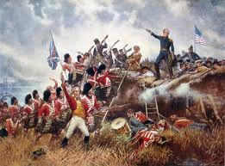
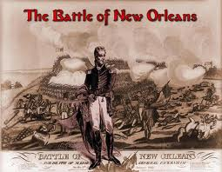
Battle of new Orleans
This was held on January, 8, 1815. they U.S defeated Britain in 30 min. This was the bloodiest part of the war. The British suffered 300 killed and 1200 wounded while the Americans counted 13 killed and 52 wounded or missing. The Americans war about bankrupt at this time. The treaty of Ghent was signed two weeks before the war and it was not announced yet.

