Slide 1
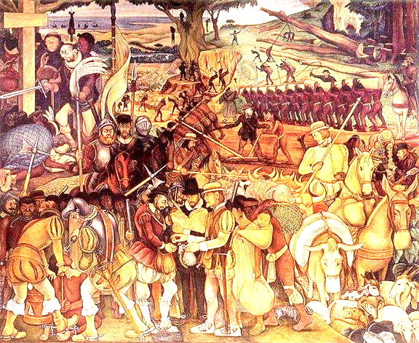
Three Worlds Meet
The US is a diverse nation it has been shaped by many different cultures ethnicities and religions

Slide 2
Unit 3 Test
Students will be put into groups of 3 on Canvas. Each student will represent either Native Americans, European Explorers, or Africans.
Share with your group why you are in the Americas and what you want/need in the America’s.
Create a solution for peaceful coexistence in the Americas that allows for the survival of each group.
Civic Dialogue (October 12-17)

Slide 3
Homework
Please bring a treat to class for the following class period. Treats may be individual or group treats. Put some thought into your treats, try to bring something that is unique and/or represents the diversity found in the United States today.

Slide 4
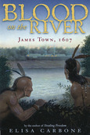
Historical Fiction Novel
Please see instructor for ACAD option
Choose ONE of the six novels:
Prior to reading your chosen novel read the Historical note or authors note associated with each novel. Be prepared to answer questions regarding the text.
Read your chosen novel. While reading, write brief paragraphs (three lines/ 3-5 sentences) summaries of each section listed in the Reading chunks and Summaries pages that follow.
When finished reading your chosen novel answer the Historical Character questions about your chosen novel AND the questions specific to your novel in the pages that follow.
You will have 1 ½ months to finish your novel and the questions.

Slide 5
A Diverse America: Sitting on our Plate
Please put your treat up on the counter in front.
With your table partner identify 15 foods, laid out on the table, i.e.
1. B Chick’o’sticks
With your partner, identify three primary ingredients AND their place of origin within each food. I.e.
1. B Chick ‘o’stick , Corn Syrup (America), Peanut Butter (America) & Coconut (Polynesia)
Next, award the following! You must use the ingredients of that food as your evidence that your group is correct.
Most European
Most (Native) American
Most African
Most Asian
Most Combined
What does the food we eat everyday teach us about the Story of America?

Slide 6
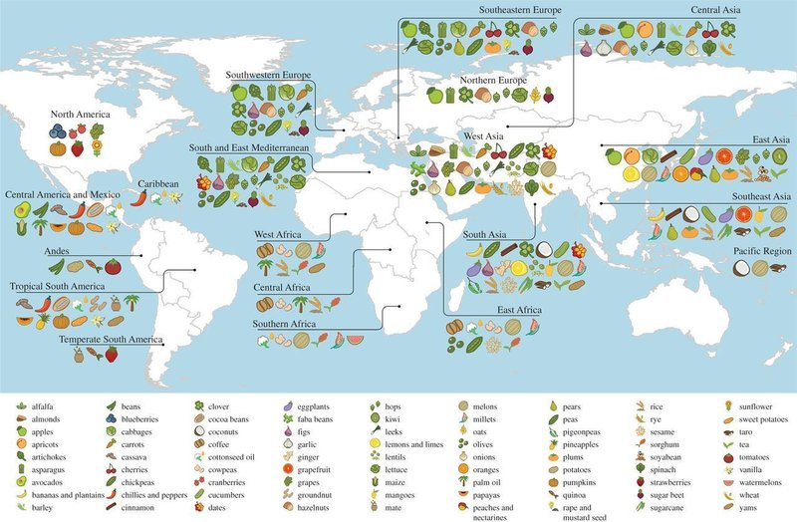

Slide 7
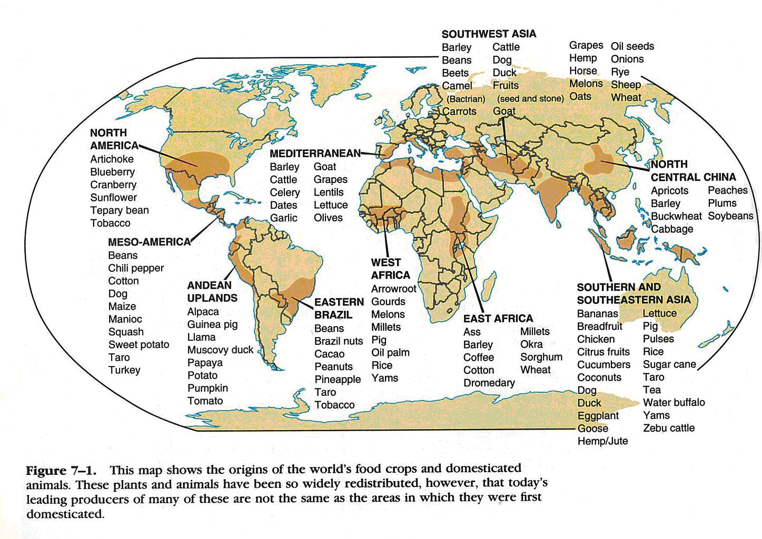

Slide 8
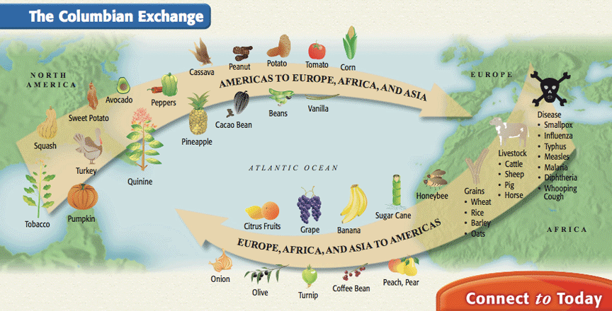

Slide 9
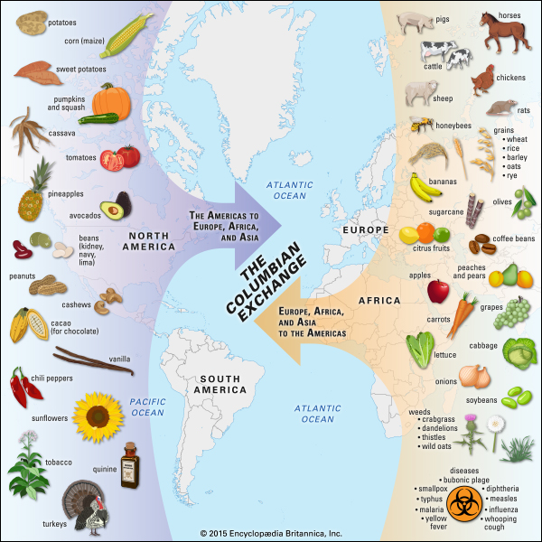

Slide 10
Food Timeline

Slide 11
Historical Fiction Novel
Please see instructor for ACAD option
Choose ONE of the six novels:
Prior to reading your chosen novel read the Historical note or authors note associated with each novel. Be prepared to answer questions regarding the text.
Read your chosen novel. While reading, write brief paragraphs (three lines/ 3-5 sentences) summaries of each section listed in the Reading chunks and Summaries pages that follow.
When finished reading your chosen novel answer the Historical Character questions about your chosen novel AND the questions specific to your novel in the pages that follow.
You will have 1 ½ months to finish your novel and the questions.

Slide 12
Our Foods: Take Away
What does the food we eat everyday teach us about the story of America?

Slide 20
United States of America
A Diverse Nation

Slide 21
Other examples of America as a Diverse Nation

Slide 22
Name a Disney Movie

Slide 23
Name Your Favorite Sports Team

Slide 24
Name Favorite Music

Slide 25
Let’s test your pre-columbian knowledge

