Slide 1
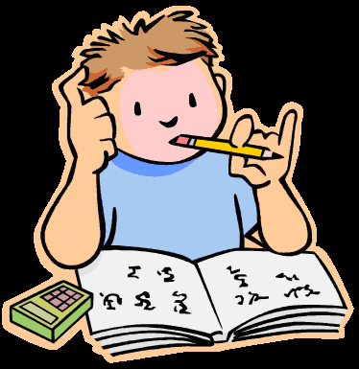
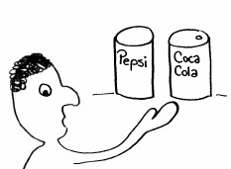
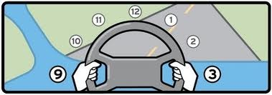
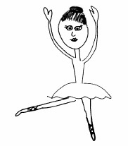
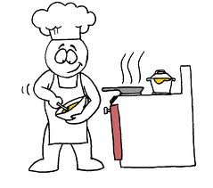
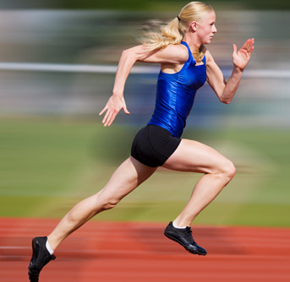
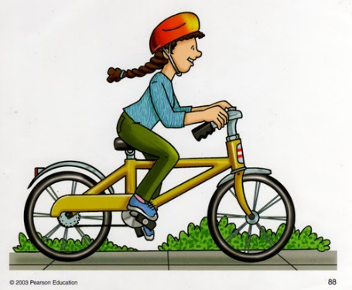
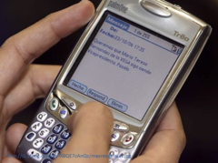
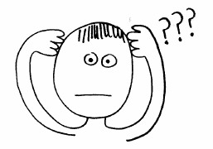
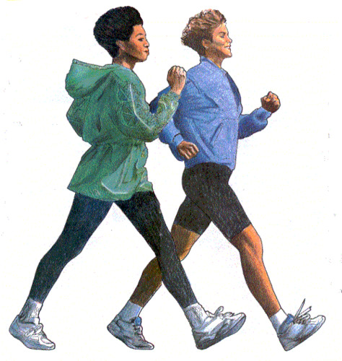
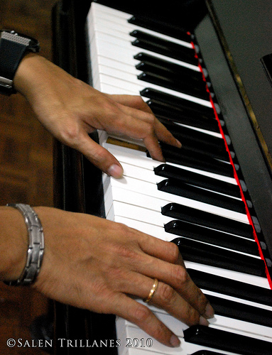
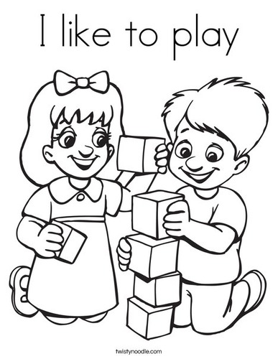
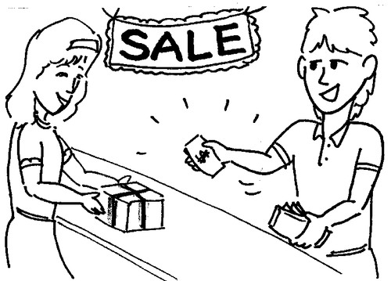
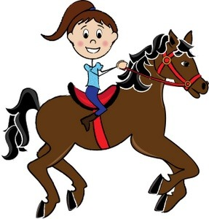

Slide 2
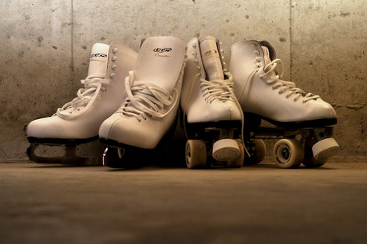
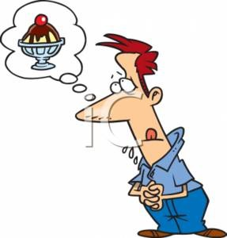
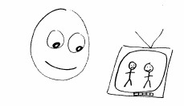

Slide 3
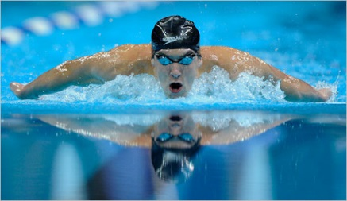
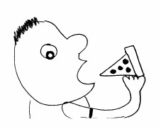
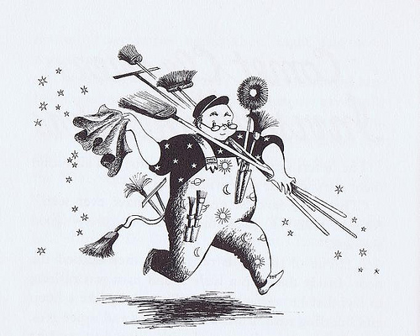
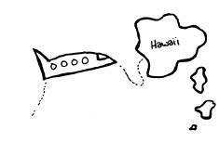

Slide 4
Cocinar= To Cook
Playing Board 1
Playing Board 2
Playing Board 3

Slide 5
Dibujar= To Draw
Playing Board 1
Playing Board 2
Playing Board 3

Slide 6
Ir= To Go
Playing Board 1
Playing Board 2
Playing Board 3

Slide 7
Estudiar= To Study
Playing Board 1
Playing Board 2
Playing Board 3

Slide 8
Preferir= To Prefer
Playing Board 1
Playing Board 2
Playing Board 3

Slide 9
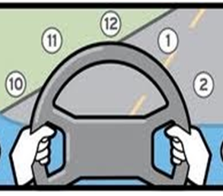
Manejar o Conducir
To Drive
Playing Board 1
Playing Board 2
Playing Board 3

Slide 10
Bailar
To Dance
Playing Board 1
Playing Board 2
Playing Board 3

Slide 11
Ir de Compras
To go shopping
Playing Board 1
Playing Board 2
Playing Board 3

Slide 12
Pensar
To Think
Playing Board 1
Playing Board 2
Playing Board 3

Slide 13
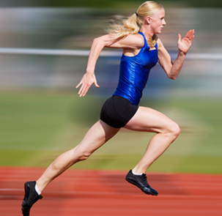
Correr
To Run
Playing Board 1
Playing Board 2
Playing Board 3

Slide 14
Poder
To be able to
Playing Board 1
Playing Board 2
Playing Board 3

Slide 15
Andar en Bicicleta
To Ride a Bike
Playing Board 1
Playing Board 2
Playing Board 3

Slide 16
Enviar un Texto
To Send a Text
Playing Board 1
Playing Board 2
Playing Board 3

Slide 17
Caminar, Andar, o Pasear
To Walk
Playing Board 1
Playing Board 2
Playing Board 3

Slide 18
Tocar un Instrumento
To play an instrument (Piano)
Playing Board 1
Playing Board 2
Playing Board 3

Slide 19
Navegar en internet
Surf the web
Playing Board 1
Playing Board 2
Playing Board 3

Slide 20
Practicar
To Practice
Playing Board 1
Playing Board 2
Playing Board 3

Slide 21
Dormir
To Sleep
Playing Board 1
Playing Board 2
Playing Board 3

Slide 22
Escribir
To Write
Playing Board 1
Playing Board 2
Playing Board 3

Slide 23
Charlar o Chatear
To Chat or Discuss
Playing Board 1
Playing Board 2
Playing Board 3

Slide 24
Jugar
To Play
Playing Board 1
Playing Board 2
Playing Board 3

Slide 25
Nadar
To Swim
Playing Board 1
Playing Board 2
Playing Board 3

Slide 26
Trabajar
To Work
Playing Board 1
Playing Board 2
Playing Board 3

Slide 27
Hablar por teléfono
To talk on the telephone
Playing Board 1
Playing Board 2
Playing Board 3

Slide 28
Pasar Tiempo con Amigos
Pass time (hang out)
With Friends
Playing Board 1
Playing Board 2
Playing Board 3

Slide 29
Comprar
To Buy
Playing Board 1
Playing Board 2
Playing Board 3

Slide 30
Montar (Caballos)
To Ride (Horses)
Playing Board 1
Playing Board 2
Playing Board 3

Slide 31
Amar
To Love
Playing Board 1
Playing Board 2
Playing Board 3

Slide 32
Ver
To See
Playing Board 1
Playing Board 2
Playing Board 3

Slide 33
Hacer Ejercicios
To (do/make) exercise
Playing Board 1
Playing Board 2
Playing Board 3

Slide 34
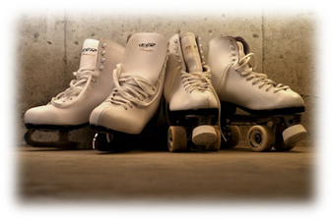
Patinar
To Skate
Playing Board 1
Playing Board 2
Playing Board 3

Slide 35
Querer
To Want
Playing Board 1
Playing Board 2
Playing Board 3

Slide 36
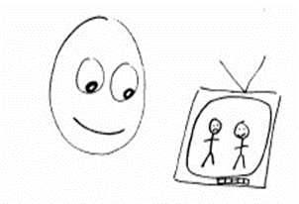
Mirar
To look
Playing Board 1
Playing Board 2
Playing Board 3

Slide 37
Cantar
To Sing
Playing Board 1
Playing Board 2
Playing Board 3

Slide 38
Leer
To Read
Playing Board 1
Playing Board 2
Playing Board 3

Slide 39
Comer
To Eat
Playing Board 1
Playing Board 2
Playing Board 3

Slide 40
Beber o Tomar
To Drink
Playing Board 1
Playing Board 2
Playing Board 3

Slide 41
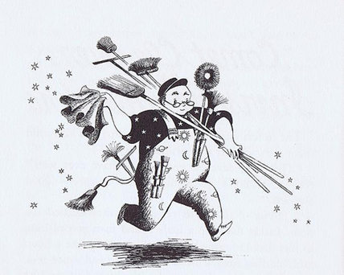
Trabajar
To Work
Playing Board 1
Playing Board 2
Playing Board 3

Slide 42
Hacer
To Make or Do
Playing Board 1
Playing Board 2
Playing Board 3

Slide 43
Escuchar
To Listen
Playing Board 1
Playing Board 2
Playing Board 3

Slide 44
Viajar
To Travel
Playing Board 1
Playing Board 2
Playing Board 3

Slide 45
Hacer Tarea
To do/make Homework
Playing Board 1
Playing Board 2
Playing Board 3

